Slide 1
Medical Forensic
Sexual Assault Examinations:
What Are They, and
What Can They Tell the Courts?
National Judicial Education Program
A Project of Legal Momentum
in cooperation with the
National Association of Women Judges
Created with Support from
The Walter & Phyllis Borten Family Foundation
and the Office on Violence Against Women,
U.S. Department of Justice

Slide 2
Topics Covered
Need for Medical Forensic Sexual Assault Examinations; SANE Program History and Training
Medical Forensic Sexual Assault Examinations and Evidence Collection Kits
Suspect Examinations
Telemedicine
SANEs in the Courtroom
Recommendations for Judges
Case Study and Decision Making Exercises

Slide 3
Centers for Disease Control 2010 National Intimate Partner and Sexual Violence Survey*
1 in 5 U.S. women has been raped at some point in her life.
1 in 10 U.S. women has been raped by an intimate partner.
1 in 71 U.S. men has been raped at some point in his life.
1.2 million U.S. women were raped during the 12 months preceding the survey.
*Michele C.Black et al., The National Intimate Partner and Sexual Violence Survey (NISVS): 2010 SUMMARY REPORT, National Center for Injury Prevention and Control, Centers for Disease Control and Prevention (Nov. 2011), http://www.cdc.gov/ViolencePrevention/pdf/NISVS_Report2010-a.pdf.
Notes:
Suggested Commentary
The National Intimate Partner and Sexual Violence Survey: 2010 Summary Report, published by the National Center for Injury Prevention and Control of the Centers for Disease Control, defined rape as including forced vaginal, oral, or anal penetration with a penis; forced digital vaginal or anal penetration; attempted forced penetration; and completed alcohol or drug-facilitated penetration.
Rape is an epidemic crime with grave consequences for victims, female and male. Few victims report and extremely few ever see the inside of a courtroom. A national study of rape victims found that only 18% of forcible rape victims and 10% of drag-facilitated/incapacitated rape victims reported the crime to law enforcement.
The vast majority of rapes are committed by someone known or related to the victim.
Jenifer Markowitz, ND, RN, WHNP-BC, a former President of the International Association of Forensic Nurses, estimates that fewer than 10% of the patients she sees for medical forensic sexual assault examinations ultimately go to trial.
As the CDC’s data show, both women and men are victims of rape. However, since women are victimized at significantly higher rates, this presentation often uses female pronouns for patients and victims.
SANE Faculty provides comments based on experience from own practice.
Sources:
Dean Kilpatrick et al., Drug-Facilitated, Incapacitated and Forcible Rape: A National Study (2007), at 4, www.ncjrs.gov/pdffiles1/nij/grants/219181.pdf.
Michele C. Black et al., The National Intimate Partner and Sexual Violence Survey (NISVS): 2010 SUMMARY REPORT, National Center for Injury Prevention and Control, Centers for Disease Control and Prevention (Nov. 2011), http://www.cdc.gov/ViolencePrevention/pdf/NISVS_Report2010-a.pdf.
Kimberly A. Lonsway & Joanne Archambault, The ‘Justice Gap’ for Sexual Assault Cases: Future Directions for Research and Reform, 18 Violence Against Women 145, (2012).

Slide 4
Medical Evidence in Rape Trials
Inaccurate assumptions about medical evidence in adult victim sexual assault trials undermine fairness in the justice system.
Notes:
Suggested Commentary:
Adult victim sexual assault trials bring with them expectations about the kind of injuries a “real” victim will have, the kind of medical evidence that will be offered, who will present it, and what medical evidence can “prove” in these cases. These expectations are at odds with reality and undermine fairness in all aspects of the trial process.
This curriculum provides accurate information about the medical forensic sexual assault examination and what it can and cannot prove, and explores some of the legal issues these cases raise for judicial resolution.

Slide 5
What is a Medical Forensic Sexual Assault Examination?
A medical examination that integrates the collection of forensic evidence so that if a patient decides to report, the evidence is correctly preserved
Guided by the National Protocol for Sexual Assault Medical Forensic Examinations, Adults/Adolescents (2d ed. 2013) or local protocol
5
Notes:
Suggested Commentary:
SANE Faculty explains the National Protocol and local protocol if there is one.
The National Protocol for Sexual Assault Medical Forensic Examinations was developed by the Office on Violence Against Women in the U.S. Department of Justice pursuant to the Violence Against Women Act of 1994, to ensure that all sexual violence victims receive informed, compassionate, competent care, and that forensic evidence is correctly collected and maintained should the patient decide to report the assault. The first edition was published in 2004. The second edition was published in 2013.
The National Protocol is a comprehensive 135-page document that provides detailed instructions on every aspect of a medical forensic sexual assault examination, from the necessary equipment to the importance of adapting the examinations to the needs of individual patients, such as patients with disabilities, and patients with Limited English Proficiency.
Many states and jurisdictions have developed their own protocols as well.
This PowerPoint is generic in that it reflects the National Protocol and provides an overview of the examination procedures rather than focusing on variations for individual types of patients.
10/24/13

Slide 6
Purposes of the Medical Forensic
Sexual Assault Examination
Focuses on patient’s immediate, short term, and long term health and safety needs, as part of the healing process
Saves patient from being subjected to a second examination for forensic purposes
Preserves and documents evidence should patient decide to report at the time of the exam or in the future
Copyright © 2013 Legal Momentum
6
Notes:
Suggested Commentary:
This is a dual purpose examination, combining medical evaluation and treatment with forensic examination and evidence collection, because combining these steps is best practice from the viewpoint of patient-centered care. Combining these steps yields a shorter, less intrusive examination.
6
10/24/13

Slide 7
Violence Against Women Act
Under the 2005 Reauthorization of the Violence Against Women Act (VAWA):
  States may not require a victim of sexual assault to participate in the criminal justice system or cooperate with law enforcement in order to receive a medical forensic sexual assault examination.
  States may not require victims to pay for these examinations themselves.
  Source: Violence Against Women Act of 2005, 42 U.S.C. § 3796gg-4.
Copyright © 2013 Legal Momentum
7
Notes:
Suggested Commentary:
VAWA 2005 states that a state or jurisdiction may not “require a victim of sexual assault to participate in the criminal justice system or cooperate with law enforcement in order to be provided with a forensic medical exam, reimbursement of charges incurred on account of such exam, or both.”
The National Protocol for Sexual Assault Medical Forensic Examinations Adults/Adolescents (2nd ed. 2013) states that “states are required as a condition of eligibility for STOP Violence Against Women Formula grant funds to allow victims to receive examinations and to have the examinations paid for regardless of the level of participation of victims in the criminal justice system.”
Unless patients are in a jurisdiction with mandatory reporting, they have several options with respect to reporting. [If yours is a mandatory reporting jurisdiction, explain]
Patients may report at the time of the exam
Patients may direct that their evidence collection kit be sent to storage, after which they can decide to report in the future, or to never report
The National Protocol encourages jurisdictions to create anonymous/blind reporting procedures so that law enforcement can gain information about sex crimes that would otherwise go unreported, while victim privacy is protected
Source: Office on Violence Against Women, U.S. Department of Justice, A National Protocol for Sexual Assault Medical Forensic Examinations 52 (2nd ed. 2013), available at http://ncjrs.gov/pdffiles1/ovw/206554.pdf.
7
10/24/13

Slide 8
Who Conducts a Medical Forensic Sexual Assault Examination?
Optimally, a healthcare provider specially trained to provide a comprehensive, objective assessment of a patient who presents with a chief complaint of sexual assault
May be a nurse, a doctor, or other type of healthcare professional
Known as a SANE (Sexual Assault Nurse Examiner) or SAFE (Sexual Assault Forensic Examiner)
Copyright © 2013 Legal Momentum
8
Notes:
Suggested Commentary:
Because most of these healthcare providers are nurses, this presentation uses the term SANE—the acronym for Sexual Assault Nurse Examiner—to denote all trained examiners.
A SANE may be a registered nurse or a nurse practitioner. A SAFE—Sexual Assault Forensic Examiner—may be a physician, or a physician’s assistant.
SANE programs may be located in hospital emergency departments or freestanding community clinics.
In the many jurisdictions that lack SANE programs, these examinations are carried out by the ER personnel on duty, on occasion with telemedicine remote supervision by a SANE. Telemedicine is discussed later in this presentation.
8
10/24/13

Slide 9
SANE Training
  Includes rigorous, specialized classroom and clinical components
  40 hours of classroom training based on guidelines developed by the International Association of Forensic Nurses (IAFN)
  40-96 hours of clinical training under supervision of an experienced SANE to gain proficiency in performing the medical forensic sexual assault examination
9
Notes:
Suggested Commentary:
SANE Faculty describes local requirements for SANE training and certification
Gives examples of topics covered in training, e.g.:
Classroom Training:
Forensic Nursing
SANE/SAFE roles and responsibilities
Medical forensic sexual assault examination
Criminal justice system education
Clinical Training:
Detailed genital inspections
Visualization techniques
Proper use of equipment
Performance of sexual assault medical forensic exams under the supervision of an experienced SANE or SAFE
Observation of rape trials
Beyond the full SANE/SAFE course and clinicals, some states offer certification at the state level.
The International Association of Forensic Nurses offers Board Certification, for nurses only, after at least a year of practice so that clinical competency as well as baseline training can be measured.
Only one state, Nevada, requires Board Certification for a SANE to practice. Nurses practicing in states that certify SANEs at the state level must have that certification to practice.
9

Slide 10
SANE Training
Continuing Education:
  SANEs participate in continuing education
  International Association of Forensic Nurses
    Annual Conference
    Journal: Forensic Nursing
Evolving field with constant research being conducted
SANEs are extending their practice to domestic violence patients and other areas
10
Notes:
Suggested Commentary:
Examples of ongoing research:
Effort to determine whether it is possible to distinguish genital micro-tears caused by consensual sex from those caused by non-consensual sex.
Effort to extend time frame for evidence collection of DNA and drugs.
Expanding practice:
Forensic nurses work in a variety of fields in addition to sexual assault, including: domestic violence, child abuse and neglect, elder mistreatment, death investigations, corrections, and in the aftermath of mass disasters.
Source: What is Forensic Nursing?, International Association of Forensic Nurses, http://www.iafn.org/displaycommon.cfm?an=1&subarticlenbr=137 (last visited March 6, 2013).
10

Slide 11
Need for SANE Programs
“A resident came in and had this rape kit, and started opening envelopes and vials. He was fumbling around and he was very, very nervous. He did a pelvic exam, and kept apologizing. ’I’m sorry I have to do this. I’m sorry, I’m sorry.’ I remember feeling I had to comfort him and make him feel okay. This guy was supposed to be examining me and helping me, and he didn’t know what he was doing.” – Katie Feifer
  Source: Rape Victims Get Short Shrift in Illinois, Sun Times, Feb. 5, 2012, http://www.suntimes.com/news/steinberg/10414459-452/neil-steinberg-rape-victims-get-short-shrift-in-illinois.html.
11
Notes:
Suggested Commentary:
In 1988, Katie Feifer was raped at knifepoint by a man who pushed his way into her home and tied her up in her basement. At the time of the rape, Ms. Feifer worked at an advertising agency. She now serves as the research and media director for the Voices and Faces Project, a national network of survivors willing to speak out publicly about the rape and abuse perpetrated against them, www.voicesandfaces.org.
This is an example of the problems rape victims encountered before there were healthcare providers specially trained to provide victims with effective medical care and evidence collection.

Slide 12
Before There Were SANE Programs
Victims waited hours to be seen because ER staff did not see these as urgent cases
Medical professionals who conducted exams were often uneducated and insensitive about sexual assault
They often lacked specialized training to provide victim centered care, perform medical forensic examinations, provide safety planning at discharge, and testify in court
.
Source: TK Logan, Jennifer Cole, and Anita Capillo, Sexual Assault Nurse Examiner Program Characteristics, Barriers, and Lessons Learned. 3 Journal of Forensic Nursing 24 (2007).
Notes:
Suggested Commentary:
Because few victims have serious, observable physical injuries, ER staff did not consider their cases urgent.
Victims are told not to urinate, defecate, brush teeth, shower, bathe, douche, drink or eat until after the medical forensic examination in order to preserve evidence. Some victims could not endure the long ER waits with these restrictions and just left.
Mistaken Assumptions: Uneducated medical staff assumed that, E.g.:
“Real” rape victims resist to the utmost and have grave physical injuries
“Real” rape victims have severe genital injuries
Victim Blaming: Uneducated medical staff asked patients accusatory questions, E.g.:
“Why were you out so late? Why were you wearing such a skimpy skirt? Why didn’t you fight back?”
Emotional / Psychological Needs Unmet: Uneducated medical staff had little or no understating that absence of observable physical injuries did not mean victim was not profoundly injured psychologically. Exams were not conducted with respect.
Incompetent Evidence Collection: ER staff without specialized training were often inept and sometimes resentful of the hours-long exams and attention to detail the evidence kit requires.

Slide 13
History
Victims’ Rights and Women’s Movements
  Opened shelters for female victims of sexual assault and domestic violence
  Advocated for statutory reform of rape laws
Pioneer SANE programs grew
  Able to combine health care and forensic components to prevent victims from being subjected to multiple exams by insensitive, uneducated, victim-blaming medical professionals
13

Slide 14
Founding and Expansion of SANE Programs
1976 – First SANE program established in Memphis, TN
1990 – Flowering of SANE programs nationwide
1992 – International Association of Forensic Nurses (IAFN) established
By 2001, more than 300 programs
By 2013, more than 600 programs
Source: Linda E. Ledray, SANE Development Operation Guide (1999).
14
Notes:
Suggested Commentary:
Despite the flowering of SANE programs across the country, many communities cannot afford to establish SANE programs, or maintain them once established. Many victims are still examined by whoever is on ER duty when they arrive at the hospital, and these examinations may not be as well-conducted as those conducted by a SANE. Similarly, women who go to their primary physicians may encounter doctors without the specialized skill to conduct the examination.
Researchers are exploring the use of telemedicine as a way to address the gap in services.

Slide 15
Terminology: Patient/Victim
SANEs refer to those seeking care as patients, as does the National Protocol for Medical Forensic Sexual Assault Examinations (2nd ed. 2013).
“Victim-centered care” is the term the National Protocol uses to describe the criteria for sexual assault examinations.
When a SANE uses the term “victim” it is not as a legal conclusion, but with reference to the standards of care.
The Federal Crime Victims’ Rights Act uses the term “victim” for claimants at all stages of the criminal justice process.
Copyright © 2013 Legal Momentum
15
Notes:
Suggested Commentary:
The National Protocol for Sexual Assault Medical Forensic Examinations uses the phrase “victim-centered care” because that is the terminology used in the Violence Against Women Act, which directed that a protocol be developed.
The Federal Crime Victims’ Rights Act, enacted as a part of the Justice for All Act of 2004 (18 U.S.C. Sec. 377), details crime victims’ rights before, during, and after a prosecution. The Act uses the term “victim” throughout. Therefore, this curriculum uses that terminology as well.
SANEs make no judgment as to the veracity of a patient presenting with a complaint of sexual assault or the patient’s account of the sexual assault.
When a patient presents with sexual assault as her or his chief complaint, that is what guides the SANE’s examination.
Emphasize that taking patients at their word is not unique to sexual assault cases. This is the basis for the rule of evidence called the Medical Hearsay Exception which assumes that patients seeking medical treatment tell their healthcare providers the truth because it is in their own best interest to do so. (Federal Rule of Evidence 803, see SANEs IN THE COURTROOM section).
15
10/24/13

Slide 16
Benefits of SANE Programs
Effective psychological, medical, and forensic services provided by a knowledgeable, sensitive and objective medical professional
Integrating the medical and forensic exams spares the victims and minimizes retraumatization
Examiner knows how to conduct the forensic medical evidence examination and is available to testify in court if necessary
Sources: TK Logan, Jennifer Cole, & Anita Capillo, Sexual Assault Nurse Examiner Program Characteristics, Barriers, and Lessons Learned. 3 Journal of Forensic Nursing 24 (2007);
Linda A. Hutson, Development of Sexual Assault Nurse Examiner Programs, 37 Nurs. Clin. North Am. 79 (2002)
16

Slide 17
Medical Forensic Sexual Assault Examinations are Part of the Healing Process
“For individuals who experience this horrendous crime, having a positive experience with the criminal justice and health care systems can contribute greatly to their overall healing.”
Source: Office on Violence Against Women, U.S. Department of Justice, A National Protocol for Sexual Assault Medical Forensic Examinations 52 (2nd ed. 2013), available at http://ncjrs.gov/pdffiles1/ovw/206554.pdf.
17
Notes:
Suggested Commentary:
Research on the effectiveness of SANE programs has found that when patients have a good healthcare experience it makes them more willing to report and engage with the justice system.
Source:
Rebecca Campbell et al., Using Ecological Theory to Evaluate the Effectiveness of an Indigenous Community Intervention: A Study of Sexual Assault Nurse Examiner (SANE) Programs, 46 Am. J of Cmty. Psychology 263 (2010).

Slide 18
Medical Forensic Sexual Assault Examinations and
Evidence Collection Kits

Slide 19
Medical Forensic Sexual Assault Examinations
Examination is guided by the National Protocol for Sexual Assault Medical Forensic Examinations (2d ed., 2013) or a local protocol
Examination is lengthy, invasive, and requires exacting attention to detail.
Medical issues and treatment needs always take priority over forensic exam and evidence collection
Notes:
Suggested Commentary:
SANE Faculty cites the protocol that guides evidence collection in your state
This is a medical exam that integrates forensic evidence collection to minimize retraumatization of the victim by making a second exam unnecessary, and preserves evidence should the patient decide to report to law enforcement.
While some victims may see a SANE at the suggestion of police, an exam by the SANE does not mean that victims must go forward with criminal proceedings.
Thus, patient is first examined, assessed, and treated for immediate, acute medical needs.
Patient’s immediate medical needs may include:
Medication for a condition such as diabetes or asthma
Wounds
Panic attacks
SANE Faculty provides examples from own practice.
If patient reports circumstances indicating drug-facilitated rape, urine and blood samples are collected immediately.
Examination is not typical for an ER in that it requires a great deal of uninterrupted time, typically 2-6 hours, by a single examiner present throughout. This is necessary to preserve the chain of custody.
Requires familiarity with the many parts and complexity of the evidence collection kit and extremely detailed documentation.

Slide 20
Comprehensive Sexual Assault Assessment Form
All steps of the exam are recorded on a comprehensive Sexual Assault Assessment Form, usually specific to the jurisdiction
SANE records:
  Patient’s consent or non-consent to each step of the exam
  All information and evidence the exam produces
Notes:
Suggested Commentary:
SANE Faculty provides a copy of your jurisdiction’s Sexual Assault Assessment Form.

Slide 21
Components of a Medical Forensic Sexual Assault Examination
  Obtain consent
  Patient history
  Head-to-toe assessment
  Detailed genital assessment
    Only exception is if no genital contact reported by patient for adolescent/adult population
  Evidence collection
  Medication administration, discharge instructions, and safety planning
Source: Shannon Liew, SANE Coordinator, Office of the Illinois Attorney General, Sexual Assault from the Medical Perspective, Presentation at the Family Violence Symposium (Oct 19, 2012) (PowerPoint Presentation on file with Legal Momentum).

Slide 22
Informed Consent
SANEs must obtain informed consent separately for each of the following:
  Examination – to begin and for each step
  Collection of evidence
  Photographs
  Release of evidence to law enforcement
Patient may withdraw consent at any time
Patient may consent to one part of the exam but not another
Source: Shannon Liew, SANE Coordinator, Office of the Illinois Attorney General, Sexual Assault from the Medical Perspective, Presentation at the Family Violence Symposium (Oct 19, 2012) (PowerPoint Presentation on file with Legal Momentum).
Notes:
Suggested Commentary:
Patient is asked for consent before the forensic aspect of the examination begins.
Obtaining consent includes an overview of what the sexual assault medical forensic exam entails, e.g., the several steps and the fact that the exam usually several hours.
As the exam proceeds, the SANE explains at each step exactly what she is about to do and obtains consent for that particular step and type of evidence collection.
Patient may consent to one part of the exam but not another.
E.g, patient may consent to the SANE swabbing an area where the assailant licked her, in order to obtain a DNA sample, but refuse consent to photographing her internal injuries.
Patient may withdraw consent to the exam or any step of the exam at any time.
After exam is complete, patient is asked whether she wishes it released to law enforcement or stored for future release.
Patient must be told what the storage time frames are for her jurisdiction: i.e., how long will the hospital store the evidence collection kit before destroying it.
SANE Faculty describes storage protocol for your jurisdiction.

Slide 23
Confidentiality and Rape Shield Laws
Defense may seek medical history to show someone other than defendant is source of patient’s injuries, raising Rape Shield Law issues
Only forensic information relevant to the investigation should be released
Notes:
Suggested Commentary:
Obtaining consent involves informing patient as to which parts of the exam will be kept confidential.
SANE Faculty explains her facility’s protocol for ensuring confidentiality, so that information irrelevant to the case, e.g., patient’s reproductive health history, does not become public.
Rape Shield Law
Defense may seek medical history information about patient’s recent sexual activity to show that a third party is responsible for patient’s injury or pregnancy. Asking the court to require release of this information raises Rape Shield Law issues.
SANE Faculty provides examples from own practice.
Judge Faculty comments on any confidentiality issues in cases he or she has tried.
Every jurisdiction has a Rape Shield Law which bars questioning the victim about her prior sexual conduct apart from sexual conduct with the defendant. Most of these laws also include an exception when the defense alleges that it was the victim’s sexual activity with someone other than the defendant that is the source of the semen, pregnancy, disease, or injury in the present case.
In cases in which this is a possibility, the defense will want to know what the patient told the SANE about recent sexual partners, or about a recent abortion that might have left internal scarring.
The defense will ask the court to direct the treating SANE to release this information. The prosecution will make a motion in limine to resist release of any part of the patient’s medical record or to closely limit what may be released so that private information about past pregnancies, abortions, sexually transmitted infections, SSR-medications, and birth control is not made public. The court decides whether and what may be released, usually after an in camera (closed) review of the information requested. That is, the judge reviews the history privately before making a decision.

Slide 24
Patient’s Demeanor
SANE records patient’s:
  Orientation
  General appearance
  Behavior
  Responsiveness to questions
Source: Shannon Liew, SANE Coordinator, Office of the Illinois Attorney General, Sexual Assault from the Medical Perspective, Presentation at the Family Violence Symposium (Oct 19, 2012) (PowerPoint Presentation on file with Legal Momentum).
Notes:
Suggested Commentary:
SANE Faculty explains meaning of “orientation,” e.g., does patient know date?, who is president?, purpose of recording this information? These questions are essential to determine whether patient can give informed consent to examination.
If patient is confused and not responsive to questions it may mean that she was drugged, calling for urine and blood samples to be collected immediately.
Patients of all kinds are brought into the Emergency Department in a disoriented or even unconscious state, unable to give informed consent. Emergency Departments usually have their own protocols for determining how to care for these patients. SANE Faculty can describe protocol for facility.

Slide 25
Patient’s History
SANE takes patient’s detailed medical history, which:
  Determines needs for immediate medical care, e.g., insulin, asthma medication
  Informs understanding of appearance of genital structures during genital assessment
  Determines what prophylactic medications should be prescribed at discharge
Source: Shannon Liew, SANE Coordinator, Office of the Illinois Attorney General, Sexual Assault from the Medical Perspective, Presentation at the Family Violence Symposium (Oct 19, 2012) (PowerPoint Presentation on file with Legal Momentum).
Notes:
Suggested Commentary:
A complete history includes:
Known allergies
Current medications
Tetanus and Hepatitis B vaccination
Last menstrual period
Current pregnancy status
Anogenital surgery/procedures
Relevant medical conditions
History of intercourse within 72 hours (distinguish vaginal, oral, anal)
Birth control method used—whether condom used in assault
Pain assessment
Knowing patient’s medical history is essential for treating immediate medical needs, guiding and understanding examination findings, and administering prophylactic medications at discharge. For example:
If patient is diabetic and in immediate need of insulin.
Reproductive/genital surgery and health conditions affect the appearance of genital structures. E.g., if patient is transgender and has undergone genital reconstruction surgery; if patient has undergone female genital cutting; if patient suffers from genital herpes.
Medications prescribed at discharge, such as those to prevent sexually transmitted infections, HIV, and pregnancy, may interact negatively with medications the patient is currently taking.

Slide 26
Patient History
SANE listens to and records patient’s account of the assault
Purpose is not to determine veracity, but because patient’s account guides the SANE’s examination, evidence collection, and discharge planning.

Slide 27
SANE Documents Patient’s History
Specifics of the incident:
  Date/time of assault
  Physical surroundings during assault
  Whether patient had the ability to give consent
  Consumption of drugs/alcohol (how much) by patient
  Did patient scratch or injure perpetrator?
  Means of assault
  Whether force or coercion was used
    Weapons, grabbing, hitting, slamming, biting, torture, mere presence, strangulation
Source: Shannon Liew, SANE Coordinator, Office of the Illinois Attorney General, Sexual Assault from the Medical Perspective, Presentation at the Family Violence Symposium (Oct 19, 2012) (PowerPoint Presentation on file with Legal Momentum).
Notes:
Suggested Commentary:
These specific questions are asked to guide the examiner, so SANE can specifically know what to look for: what evidence to collect, test and document; whether any additional or special tests are required; and guidance needed in discharge planning. For example, SANE needs to educate patient who was strangled about the many serious symptoms that may emerge after discharge, ranging from a need for speech therapy to brain damage.
Record of patient’s account should include:
Patient’s account of what happened in his or her own words, as best as he or she can recall.
Research on the neurobiology of trauma documents that the memory of a traumatic event is often difficult to recall sequentially and takes time to cohere.
Inability to recall the sequence of events may also indicate drug-facilitated rape.
Assailant’s words and actions.
Patient’s words, feelings, thoughts, and actions, for possible psychological effects
With respect to guiding the exam, SANE needs to know, for example, was there oral penetration which would require mouth swabs? Was there anal penetration, requiring an anogenital exam? Are there areas of the body where assailant bit, licked, or spat on patient which should be swabbed for DNA?
SANE also documents patient’s post-assault hygiene and activity. Needs to know whether patient bathed, showered, douched, ate, drank, etc., in order to guide the evidence collection.
Source: Interview by Nat’l Institute of Justice with Rebecca Campbell, Michigan State University (Dec. 2012), available at http://nij.ncjrs.gov/multimedia/video-campbell.htm.

Slide 28
Assailant Information
  Identifying information about assailant is documented:
    Name, if known
    Relationship to patient
    Number of perpetrators if more than one
    Informs examination and discharge plan
Source: Shannon Liew, SANE Coordinator, Office of the Illinois Attorney General, Sexual Assault from the Medical Perspective, Presentation at the Family Violence Symposium (Oct 19, 2012) (PowerPoint Presentation on file with Legal Momentum).
Notes:
Suggested Commentary:
It is important that the SANE knows the patient’s relationship to the perpetrator to guide discharge planning, which is discussed in more detail later in this PowerPoint.
HIV prophylactics is a 30 day course of extremely toxic medication. It is most effective within 24 hours but can be given up to 72 hours after an assault. Knowing who the assailant was enables SANE to better discuss with the patient whether he or she should undertake this course of treatment.

Slide 29
Types of Injuries Sexual Assault Victims May Sustain
Findings range from complete absence of injury to severe injuries.
Bruising, tearing, abrasions, swelling and petechiae may be seen in both external body and genital injuries.
Pain, alone and/or with activity, and decreased range of motion are symptoms of injury patients commonly may describe after sexual assault, even in the absence of visible injury.
Notes:
Suggested Commentary:
Explain that contrary to the stereotype that most rape victims sustain serious, observable, physical injuries, especially in the genital area, research documents that these are in fact not common. According to a national study conducted by the Medical University of South Carolina:
70% of drug-facilitated/incapacitated and 48% of forcible rape victims reported no injuries;
23% of drug-facilitated/incapacitated and 34% of forcible rape victims reported minor injuries; and
6% of drug-facilitated/incapacitated and 16% of forcible rape victims reported serious injuries.
Absence of physical injuries does not mean there was no sexual assault.
A major reason victims do not sustain serious, observable physical injuries is that most rapists employ only instrumental violence, and victims often do not physically resist.
Instrumental violence means the rapist employs only the minimum force or threat needed to make the victim submit.
Victims do not resist because they are frozen with fright; dissociated into a passive, dream-like state out of fear; or have made a strategic decision not to resist in order to avoid injury other than the rape itself, or death.
Absence of genital injuries is discussed later in this PowerPoint.
Source: Dean Kilpatrick et al., Drug-Facilitated, Incapacitated and Forcible Rape: A National Study (2007) at 4, http://www.ncjrs.gov/pdffiles1/nij/grants/219181.pdf.

Slide 30
Head-to-Toe Assessment
SANE conducts physical examination / head-to-toe assessment
  Focuses on areas where pain is noted and based on account of assault
  Visual inspection plus palpation
  SANE documents, draws, and photographs any injuries noted, from tenderness to trauma, including size, location and appearance
Source: Shannon Liew, SANE Coordinator, Office of the Illinois Attorney General, Sexual Assault from the Medical Perspective, Presentation at the Family Violence Symposium (Oct 19, 2012) (PowerPoint Presentation on file with Legal Momentum).
Notes:
Suggested Commentary:
SANE uses body map to document and draw any injuries observed. SANE notes location of injuries and describes size, shape, color, swelling, tenderness, redness, tears, abrasions, bruising, etc.
Sample of female and male body maps are on the next slides.
Note to SANE faculty: These slides can be shown rapidly just to give participants a sense of the imagery.

Slide 31
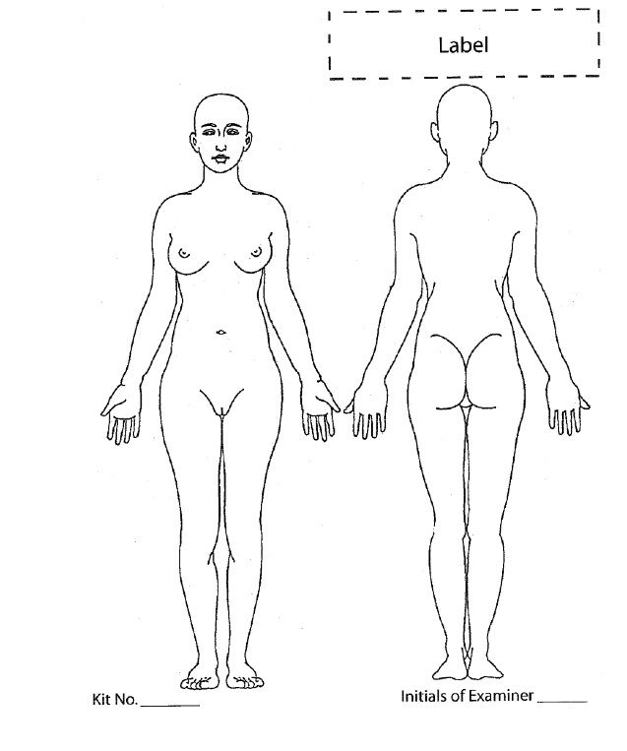

Slide 32
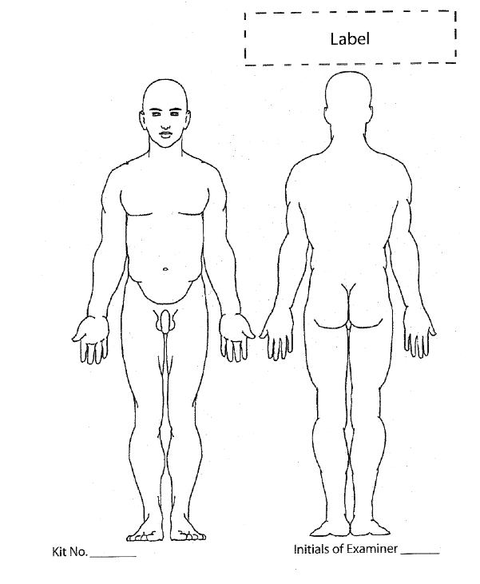

Slide 33
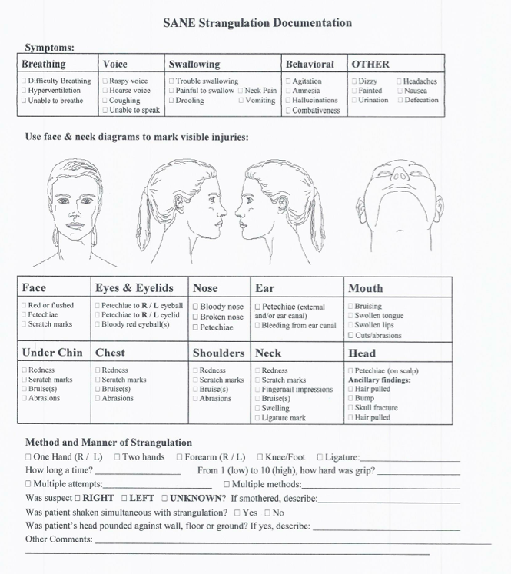

Slide 34
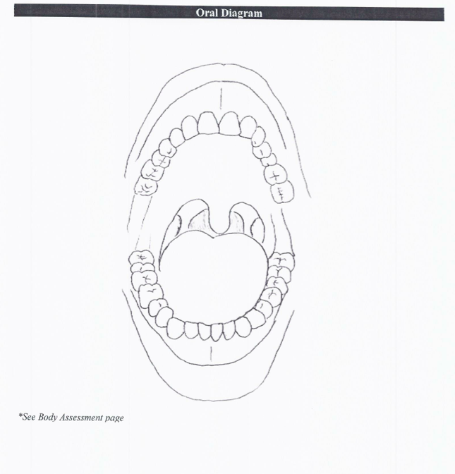

Slide 35
Detailed Genital Assessment
SANE examines external genitals, anus, vagina, and cervix for injury
  Documents, draws, and photographs any injuries
  Includes size, location, and appearance
  Utilizes aids to accurate visualization as necessary
Notes:
Suggested Commentary:
SANE uses genital map of external and internal genitalia to document and draw physical assessment of patient’s genitalia. SANE notes location of injuries and describes size, shape, color, swelling, tenderness, redness, tears, abrasions, bruising, etc.
Samples of female and male genitalia maps are on the next slides.
A glossary of terms for female and male genital structures is included in the Participants’ Binder together with diagrams. These terms are used in recording findings from and testimony about a medical forensic sexual assault examination.
Note to SANE faculty: These slides can be shown rapidly just to give participants a sense of the imagery.

Slide 36
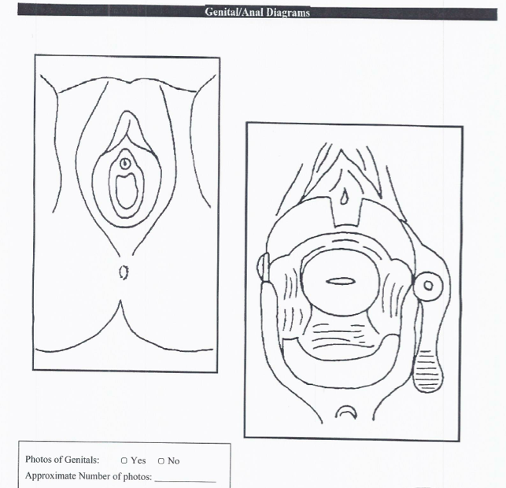

Slide 37
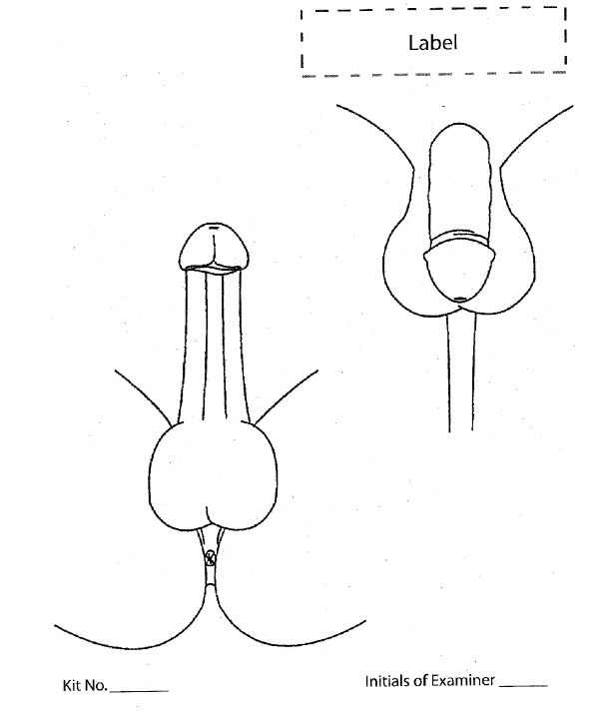

Slide 38
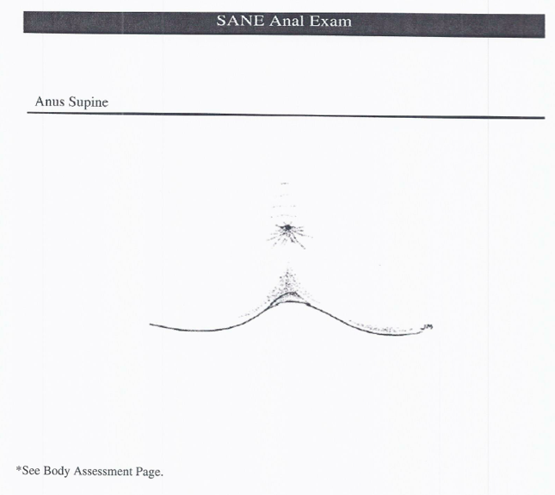

Slide 39
Aids to Accurate Visualization and Recording of
Genital Injuries
Colposcope with photographic capabilities
Digital Camera
Toluidine Blue Dye
Notes:
Suggested Commentary:
Colposcope: A magnification device used to view possible external and internal genital injuries, such as abrasions and lacerations, difficult to see or easily missed with the naked eye.
“Magnification” does not mean exaggeration or distortion. The colposcope magnifies like the otoscope that an ear, nose, and throat doctor uses to better visualize the ear canal.
Digital Camera: Many SANE programs use a digital camera only.
Toluidine blue dye:
Staining technique in which dye adheres to small areas of abraded skin and microlacerations, resulting in identification of otherwise invisible injuries.
Toluidine-blue dye resulted in significantly higher prevalence of tears and abrasions on the external genitalia than when either direct visualization or colposcopy were used.
Direct visualization and colposcopy were more effective at identifying contusions and redness.
Toluidine blue dye does not effervesce as much on dark skin as on light skin, so dark-skinned victims are receiving less effective exams. Researchers are seeking a fluorescent dye that works well on dark skin.
Sources:
Theresa Zink et al., Comparison of Methods for Identifying Ano-Genital Injury After Consensual Intercourse, 39 J. Emergency Med. 113 (2010).
Christine Phelan Kueter, U.Va.’s Laughon Testing Rape Kit Dye that Will Work on All Skin Colors (June 19, 2013),http://news.virginia.edu/content/uva-s-laughon-testing-rape-kit-dye-will-work-all-skin-colors

Slide 40
Photographing Genital Injuries
Whether genital injuries should be photographed is a controversial issue because of the risks to patient privacy.
Courts are being asked to keep access to such photos to a minimum.
Genital photographs are still commonly used for documentation purposes.
Notes:
Suggested Commentary:
Risks to patient privacy from having genital photographs in the medical forensic sexual assault examination record are so serious that some countries, e.g., Canada, bar them in their national protocols.
What can judges do to contain use of these photographs? For example, judges can establish rules for their use, such as photographs may only be seen by the defense attorney in the court house, or the prosecutor’s office.

Slide 41
Reasons for Absence of Female Genital Injuries
Many female victims have no genital injuries, for a variety of reasons:
Anatomical structure of the vagina
Vaginal vault may have been lubricated, either naturally or artificially
Delayed reporting
Victim’s age and health status
Notes:
Suggested Commentary:
Several factors may explain the lack of physical findings:
The anatomical structure of the vagina:
Comprised of muscle tissue
Designed to accept an adult penis without injury
Elastic and strong to facilitate the birth of a child
The vaginal vault may have been lubricated either naturally or artificially with
Saliva
Lubricated condoms
KY Jelly or other lubricant
Decreased friction may minimize genital abrasions or lacerations
Delayed reporting:
Often a victim may not go to the Emergency Department or visit her health care provider until many days or weeks after the incident, by which time any injuries that were present have healed.
The victim’s age and health status:
A young healthy woman is more likely to heal quickly, whereas an elderly woman’s body takes much longer to heal.
Unrecognized injuries:
If the victim was treated in a hospital where the health care providers are not specially trained in conducting sexual assault examinations, the examining health care provider may not recognize the injury.
Source: National Judicial Education Program, Legal Momentum, Understanding Sexual Violence : Prosecuting Adult Rape and Sexual Assault Cases, Presenting Medical Evidence in an Adult Rape Trial, 13 (2002), available at: http://www.mincava.umn.edu/documents/usvpros.

Slide 42
Sexual Assault
Forensic Evidence Kit
The sexual assault evidence kit, often called a “rape kit,” is actually a cardboard box or large envelope containing the equipment and containers needed to collect and store biologic and non-biologic forensic evidence from the patient’s body and clothing. The kit includes a large paper bag in which to collect the clothing itself. Additional paper bags for clothing are used as needed.
Notes:
Suggested Commentary:
Sexual assault evidence kits were first standardized in the 1970s by Louis R. Vitullo, a Chicago police sergeant who later became the chief microanalyst of the city’s crime lab, and were originally known as Vitullo kits.
Today, these kits are known by various names such as Sexual Offense Evidence Collection Kits (NY), and Sexual Assault Evidence Kits (NM).
The kits are periodically updated to reflect new evidence collection techniques.
Some states have their own requirements for kit contents.
SANE Faculty explains kit requirements in your state.

Slide 43
Sexual Assault Forensic Evidence Kit
Kit contents vary according to states and localities. A typical kit includes:
  Instructions for evidence collection
  Bags and sheets of paper for evidence collection
  Swabs for collecting fluids from lips, cheeks, thighs, vagina, anus, buttocks
  Comb to collect hair and fibers
  Envelopes for hair and fibers
  Blood collection devices
  Documentation forms
  Labels
Notes:
Suggested Commentary:
Note to SANE Faculty: Customize this slide to include your state’s kit requirements. Bring a kit and explain the purpose of each item in it.
SANE Faculty explains each step of the evidence collection
The instructions for each step of evidence collection and kit storage are extremely precise.
SANE changes gloves between each step to avoid cross contamination of evidence.
If the patient has not yet changed and the jurisdiction includes this step, patients undress standing on a sheet of paper so any evidence that falls from the patient’s clothing and body can be collected. If patients agree, clothing itself is also bagged for collection.
SANE uses swabs dipped in distilled water to collect fluids from lips, cheeks, thighs, vagina, anus and buttocks.
SANE uses alternative light source that causes semen to fluoresce to identify and swab areas of the body from which a DNA sample should be collected.
If patient states that she scratched the assailant, SANE swabs under patient’s nails to collect any skin samples of assailant.
Swabs must be air dried before being placed in kit because moist biologic evidence degrades. Moist evidence that cannot be air dried timely, such as a tampon, stored separately.
Comb is used to collect any hair and fibers that transferred from the assailant’s hair, body, and clothing and from the site of the assault, as well as dried secretions from drainage or ejaculation.
Each type of evidence is placed in its own bag or bindle, sealed, and labeled with the type of evidence collected. SANE labels envelopes and bags before placing evidence inside to minimize destruction of evidence and mix-up of evidence samples. SANE seals each envelope and bag with the labels provided and puts her initials on each label.
Conducting these lengthy and highly specialized exams calmly and with sensitivity to victims’ emotional needs is critical.

Slide 44
Sexual Assault Evidence Kit
Chain of Custody
Maintaining the chain of custody is essential for the SANE to be able to testify that the evidence could not have been tampered with or contaminated in any way during collection, packaging, storage or transfer.
Notes:
Suggested Commentary:
Chain of custody must be maintained at all times once the Sexual Assault Evidence Kit is opened. Examiner must stay with evidence collected during the exam until all evidence has been properly sealed and secured.
The examiner places his or her initials and the date on the taped seals of the various envelopes and collection bags.
Once sealed, the kit is turned over to law enforcement or to the next shift at the medical facility or placed in storage at the hospital. The next individual must take full responsibility for the evidence.
SANE Faculty explains protocol to preserve chain of custody in your facility if patient is reporting or if patient wants the kit stored for a possible future report.

Slide 45
Time Frames for
Evidence Collection
New techniques are continually extending time frames for evidence collection.
Many jurisdictions have extended collection cutoff time to 120-134 hours (5-7 days), and time limit is rapidly changing.
Traces of certain drugs can be detected in a urine sample up to 120 hours after assault.
Notes:
Suggested Commentary:
New DNA technologies are extending the time limits for collecting evidence from current patients.
Until recently the standard evidence collection cutoff time had been 72 hours from the alleged assault. Then many jurisdictions extended it to 96 hours. Now many jurisdictions have extended their cutoff times to 120 and 134 hours (5-7 days).
With respect to current patients, SANE Faculty notes cut off time for your jurisdiction.
Preliminary results from research with volunteer reproductive-aged "proxy couples" standing in for female victims and male assailants is finding that a sweep of first the cervix, and then the vaginal vault, along with enhanced DNA analysis techniques, will recover DNA from over half the women in this study at the end of a ten day period of abstinence. Researchers are now seeking to understand the individual circumstances that make this long-term recovery possible in some women but not others. For example, cyclic changes throughout the month, intervening menstrual periods, estrogen impact, and use of hormonal birth control.
New DNA technologies are also enabling forensic specialists to analyze DNA evidence from sexual assault examination kits and other types of evidence long in storage.
Source: Patricia M. Speck et al., Post Coital DNA Recovery Findings: Ongoing Results from Participating Couples, Special Session at End Violence Against Women International: Baltimore, MD (April 4, 2013).

Slide 46
Discharge Planning
SANEs prepare a discharge plan for patients presenting with sexual assault as their chief complaint as they do for all patients.
Patient-assailant relationship is one of the key considerations in customizing the discharge plan.

Slide 47
Medication and Discharge
SANE provides patient with:
  Treatment to prevent STIs and pregnancy
  Instructions for wound care and recommendations for follow-up examination
  Referrals for counseling and advocacy services
  Safety planning, if needed
Notes:
Suggested Commentary:
SANEs’ referrals for follow-up care and counseling are extremely important because of the significant physical and mental health consequences of sexual violence.
Victim Impact: Physical
Sexually-transmitted infections (STIs) including HIV/AIDS
Pregnancy/miscarriage/infertility
External injuries such as bruising, broken bones, and burns
For marital and intimate partner victims, long-lasting physical consequences because of repeated assaults, including internal injuries and chronic pain. The National Institute of Justice found that just over half of women raped by an intimate partner said they were repeatedly raped by that partner. The average was 4.6 rapes by the same partner. Individuals have reported 20 and more rapes by the same partner.
Patients sexually assaulted by someone other than an intimate partner also face an increased risk of long-term physical sequelae, including chronic pain, chronic diseases, and a potential increase in some kinds of cancer.
Victim Impact: Psychological
Post-traumatic stress disorder (PTSD) including flashbacks, hypervigilance, and nightmares
Difficulty eating and sleeping
Loss of trust in others
Suicide: contemplated, attempted, completed
Victims sexually abused as children or adolescents suffer especially severe emotional consequences
Victims raped by spouses/partners suffer profound psychological harm because they were raped by the person in whom they placed their greatest trust.

Slide 48
Discharge Safety Planning
Part of discharge planning is Safety Planning, to ensure patients are going to a safe environment where they will receive any necessary follow-up care.
In taking a patient's account of the assault, SANEs ask about her or his relationship to the perpetrator in order to craft a discharge plan specific to the patient's health and safety needs.
Notes:
Suggested Commentary:
A patient assaulted by an intimate partner will have different needs than a patient assaulted by a stranger.
If the patient was assaulted by an intimate partner, safety planning is particularly critical. The patient may need to be referred to a domestic violence shelter or helped to identify another safe place to which to return.
Intimate partner sexual assault presages increasing physical and sexual violence and potential lethality.
Individualizing the approach to sexual assault patients is critical. The context of the assault should influence the course of treatment and discharge planning.
Sources:
Lynn Hecht Schafran, Risk Assessment and Intimate Partner Sexual Abuse: The Hidden Dimension of Domestic Violence, 93 Judicature 161 (2010).
Web Course, Intimate Partner Sexual Abuse: Adjudicating This Hidden Dimension of Domestic Violence Cases, Legal Momentum National Judicial Education Program, www.njep-ipsacourse.org (last visited August 6, 2013).

Slide 49
Suspect Examinations
49

Slide 50
Suspect Examinations
Forensic sexual assault examinations of suspects are also a source of evidence
Evidence from suspect's body and clothing can establish identity of victim and victim's identification of assailant
Suspect examinations are clearly testimonial for Crawford purposes
Source: Joanne Archambault, Forensic Exams for the Sexual Assault Suspect,
11 Sexual Assault Report 33 (2007).
Notes:
Suggested Commentary:
A few states have established official protocols for suspect examinations. E.g.,
California (CA OCJP 950) – available at http://www.hawaii.edu/hivandaids/Sexual%20Assault%20Suspect%20Examination%20Form.pdf.
North Dakota: http://www.google.com/url?sa=t&rct=j&q=&esrc=s&source=web&cd=1&ved=0CDUQFjAA&url=http%3A%2F%2Fwww.ndcaws.org%2Ffile_download%2Fda2becfb-9eca-456d-b229-5407c06072fb&ei=O6jtUNzlDIXB0AHRwYEo&usg=AFQjCNEwlCRuNCy7nL892BeXKAErjwPqPg&bvm=bv.1357316858,d.dmQ&cad=rja.
If your jurisdiction has a suspect examination protocol, show and discuss it here.
Crawford issues are discussed later in the SANEs in the Courtroom unit.

Slide 51
Suspect Examinations
Can document suspect’s clothing, appearance, identifying physical characteristics and anomalies, tattoos, scars, piercings, smell, etc., that corroborate victim’s description of the assailant.
Marks on suspect’s body where victim bit, kicked, scratched, or otherwise injured suspect can help demonstrate lack of consent.
51
Notes:
Suggested Commentary:
SANE Faculty gives examples from own practice or the literature.
If the victim’s medical forensic sexual assault examination was conducted prior to the suspect examination, the victim’s account of the assault can inform the suspect examination. Information about, for example, the location of the assault and whether the victim scratched or bit the assailant, can guide the SANE to look for certain types of foreign materials on the suspect’s clothing and injuries on the suspect’s body.

Slide 52
Suspect Examinations
Biological evidence may be transferred from victim to suspect’s body or clothing.
  E.g., Digital penetration of victim’s vagina may leave DNA evidence under suspect’s fingernails
  Victim’s DNA may be found on penile swabs or suspect’s underwear
52
Notes:
Suggested Commentary:
SANE Faculty gives examples from own practice.

Slide 53
Suspect Examinations
Non-biological evidence from crime scene may be transferred to suspect’s body or clothing.
E.g., leaves from bushes outside victim’s house found on suspect’s clothing.
Notes:
Suggested Commentary:
SANE Faculty gives examples from own practice.

Slide 54
Suspect Examinations
There are several ways a suspect examination can be initiated:
  Suspect consents to exam
  Suspect is examined incident to arrest
  Suspect submits to forensic examination pursuant to a court order or search warrant
    A search warrant explicitly states which samples have been authorized by the judge for the examiner to collect.
  Exigent circumstances
  Source: Joanne Archambault, Forensic Exams for the Sexual Assault Suspect, 11 Sexual Assault Report 33, 37 (2007).
54

Slide 55
Buccal Swabs for DNA
Buccal swabs are used to collect skin cells from inside the cheek for DNA analysis
Much less intrusive than drawing blood; less expensive and time consuming because medical personnel not necessary
But cannot give the other types of forensic evidence that a complete suspect examination may yield.
55
Notes:
Suggested Commentary:
Mouth swab can be used to collect a DNA reference sample, but cannot give the additional types of forensic evidence a full exam can provide.
Can be collected by any law enforcement professional who has received training in how to collect, store, and transfer swabs.
Suspects often consent to providing buccal swabs to avoid being transported to a medical facility.

Slide 56
Buccal Swabs
In many states, buccal swabs can be collected incident to certain arrests. As of August 2013, 27 states had passed laws authorizing the collection of DNA from certain felony arrestees.
U.S. Supreme Court ruled that taking buccal swabs from suspects in custody for serious offenses is constitutionally permissible. Maryland v. King, 133 S. Ct. 1958 (2013).
Source: 27 States Have Passed the Law, DNA Saves, http://www.dnasaves.org/states.php (last visited Aug. 14, 2013).
56
Notes:
Suggested Commentary:
Judicial Faculty discusses these laws in your jurisdiction.

Slide 57
Telemedicine

Slide 58
Telemedicine
Telemedicine, also known as Telehealth and Telenursing, is an emerging practice across all medical disciplines that enables expert healthcare providers to provide guidance to less experienced providers who are geographically remote, via telecommunication technology.
Source: Jacqueline Callari-Robinson, R.N. & Jeffrey A. Kremmers, C.J., Milwaukee County, Wisconsin, What Effect Will Telemedicine Have on the Testimony of Sexual Assault Forensic Examiners?, Workshop at End Violence Against Women 2013 Conference (April 3, 2013).

Slide 59
Telemedicine for Medical Forensic Sexual Assault Examinations
Goal: Improve quality of patient care and integrity of evidence collection by providing state of the art medical and forensic examination guidance for local healthcare providers performing examinations

Slide 60
Telemedicine
Many communities cannot afford to establish or maintain SANE programs.
Telemedicine, in which an experienced SANE supervises the medical forensic sexual assault examination remotely, is an emerging practice that may help to fill the need.
Notes:
Suggested Commentary:
Examples of jurisdictions lacking SANE programs on-site that can benefit from telemedicine:
Alaska is a huge state with its population scattered in pockets, many very remote and very poor.
Alaska reported a rate of forcible rape 2.5 times higher than the national average. Source: Alaskan Justice Forum (2004)
Sexual assault victims in juvenile or adult detention settings that fall under the PREA (Prison Rape Elimination Act).
Sexual assault victims in the military, on military bases, installations, and ships across the world.
SANEs and other healthcare providers are in the earliest stages of employing telemedicine for this patient population.
In 2012, the Office of Justice Programs in the Department of Justice announced nearly $3.5 million in OJP funding to create the first ever National Sexual Assault Forensic Exam Telemedicine Center, which will provide live, 24/7, access to expert medical forensic examiners to four pilot sites in rural, tribal, military and correctional settings. This includes a nearly $3.3 million award to the Massachusetts Department of Public Health for the telemedicine center at the Newton-Wellesley Hospital and $240,000 to the U.S. Navy to support the military pilot site, as well as training and technical assistance.
At this point however, there is no real outcome data stating that telemedicine is an effective tool in adult victim sexual assault cases.
Source: Press Release, Department of Justice, Office of Justice Programs, Justice Department Announces Nearly $5.5M to Advance and Improve Victim Services (September 19, 2012) (available at: http://www.ojp.usdoj.gov/newsroom/pressreleases/2012/ojppr091912.pdf)

Slide 61
Telemedicine
A trial involving a medical forensic examination supervised remotely will present complex and novel issues:
  E.g., Testimony by both the on-site executing healthcare provider and the supervising SANE
Notes:
Suggested Commentary:
Faculty that has participated in telemedicine examination/trials can discuss own experiences.
Possible issues that may arise:
Whose exam protocol is utilized? The National Protocol for Medical Forensic Sexual Assault Examinations (2nd ed. 2013), the protocol in the examiner’s state, or the protocol in the remote supervising SANE’s state?
Quality of record keeping at both sites.
Complex licensing issues.
Practice of medicine issues.
Crawford issues.

Slide 62
SANEs in the Courtroom
62
62

Slide 63
SANE Testimony
A SANE may be called on to testify about a medical forensic sexual assault examination in a variety of criminal, civil, and family law cases:
  Sexual Assault cases (felony, misdemeanor, civil)
  Domestic Violence cases involving intimate partner sexual abuse and assault as well as strangulation
63
63
Notes:
Suggested Commentary:
Sexual assault cases may arise in criminal, civil, family, or juvenile court. E.g.,
Criminal: Felony or misdemeanor level rape or sexual assault case
Civil: Victim’s lawsuit against the defendant or a motel whose failure to provide secure premises led to rape
Domestic violence cases may be in criminal, civil, or family court. Intimate partner sexual abuse is a frequent, but all but invisible, aspect of domestic violence, and may be a factor in these cases. According to the Centers for Disease Control, 1 in 10 U.S. women has been raped by an intimate partner. E.g.,
Felony level charges against victim’s intimate partner for physical violence, strangulation, and sexual assault
Felony level charges often dropped to a misdemeanor domestic violence charge because the offender is an intimate partner
Victim of intimate partner sexual assault seeks an Order of Protection
SANE and Judicial Faculty can give examples of cases from own practice/trials
Source: Michele C. Black, et al., The National Intimate Partner and Sexual Violence Survey (NISVS): 2010 Summary Report National Center for Injury Prevention and Control, Centers for Disease Control and Prevention, (2011), http://www.cdc.gov/ViolencePrevention/pdf/NISVS_Report2010-a.pdf.

Slide 64
SANE Testimony
SANE’s role is to be a neutral healthcare professional prepared to testify for either prosecution or defense.
SANE makes no judgment as to veracity of patient’s account of sexual assault.
SANE does not repeat patient’s account of the sexual assault for the truth of it, but because it is the patient’s account that guided the SANE’s examination.
64
64
Notes:
Suggested Commentary:
SANE Faculty provides examples of in-court challenges from own practice.
Defense attorneys frequently challenge SANEs as biased in favor of patient or as part of the prosecution or law enforcement team.
The SANE’s role is to be a neutral healthcare professional prepared to testify for either prosecution or defense.
With respect to the patient’s account guiding the examination:
Example: SANE asks whether assailant licked any part of patient’s body. Patient says assailant licked her right breast. SANE swabs right breast for saliva/DNA sample.
SANE Faculty provides examples from own practice.

Slide 65
What Can A Sexual Assault Medical Forensic Examination “Prove”?
Can provide objective documentation of examination findings that can assist the court in reconstructing events in question
Cannot determine whether or not a sexual assault was perpetrated
65
Notes:
Suggested Commentary:
A medical forensic sexual assault examination cannot “prove” source or causation of injury.
When considered in the context of all the evidence, the examination findings can assist the judge and jury in reconstructing the events in question and deciding whether or not a sexual assault was committed.
The limitation on how much a medical forensic sexual assault examination can tell the court is not due only to the fact that “rape” and “sexual assault” are legal conclusions, not medical diagnoses. Often, some or all of the examination findings may be interpreted as having different theories of causation.
65

Slide 66
Genital Injuries
Rarely can the medical forensic sexual assault examination differentiate between genital injuries caused by consensual sex and those caused by non-consensual sex.
66
Notes:
Suggested Commentary:
The medical forensic sexual assault examination can document findings, if any, of injury to the external and internal genitalia. However, injury itself is not definitive for sexual assault; the types, quality, or location of injury do not necessarily allow SANEs to differentiate injury from assault from injury from consensual sex.
The majority of anogenital injuries identified on exam are nonspecific, meaning they could have been caused by either consensual or non-consensual contact. On rare occasions, the SANE may note injuries that are difficult to ascribe to consensual contact, such as deeply seated lacerations in the vaginal vault, or extensive injury requiring surgical repair. But even in those cases, the SANE cannot confirm the source of injury, but only comment on its consistency with the patient’s account of being sexually assaulted.
Research is ongoing with volunteers who are examined shortly after consensual vaginal-penile intercourse to determine whether and where they have tears, bruising, or other genital injury, and to compare these findings with data from injury patterns recorded for women subjected to non-consensual vaginal-penile intercourse. However, at the present time there are no definitive results from this research.
Moreover, it is essential to be aware of what researchers call the “ecological fallacy.” This is a logical fallacy in the interpretation of statistical data where inferences about the nature of individuals are deduced from inferences about the group to which these individuals belong. The fact that there is research documenting that something is true for a large group of people does not mean it is true for a particular individual.
As with the research on time frames for DNA collection from a patient’s cervix and vaginal vault discussed earlier, each patient is highly individual, depending on factors such as point in her menstrual cycle, type of birth control used, and use of hormone replacement therapy. These factors impact efforts to distinguish genital injuries caused by consensual vaginal-penile intercourse from those caused by non-consensual intercourse, as well as DNA collection.
Sources:
E.g., Marilyn Sawyer Sommers, Defining Patterns of Genital Injury from Sexual Assault, 8 Trauma, Violence & Abuse 270 (2007).
Sarah L. Anderson, Barbara J. Parker and Cheryl M. Bourguignon, Predictors of Genital Injury After Nonconsensual Intercourse, 31 Advanced Emergency Nursing Journal 236 (2009).
66

Slide 67
Non-Genital Injuries
Non-genital injuries may also be explained by different theories of causation offered by the prosecution and defense counsel
67
Notes:
Suggested Commentary:
The following is a case study example from Dartmouth Medical School, Sexual Assault: Forensic and Clinical Management [DVD] (2008), A Virtual Practicum based on the National Protocol for Sexual Assault Medical Forensic Examinations (1st ed.)
Patient has no memory of the time between ingesting a drink handed to her in a club and waking up in a parking lot. In response to SANE’s questions about her voluntary alcohol consumption, patient reports that she had quite a few drinks before ingesting the drink in question. In response to SANE’s question as to whether she vomited, patient reports that she vomited copiously. SANE’s examination of patient’s mouth discloses that the back of the upper part of the mouth called the soft palette was very reddened and appeared to be irritated.
During direct questioning the prosecutor elicits the information about redness and irritation and asks the SANE, who has been qualified as an expert and thus may offer an opinion, if she has an opinion as to the cause of this redness and irritation. The SANE responds that it is consistent with blunt force trauma. The prosecutor thus creates the implication that the patient was subjected to forced oral penetration by the defendant’s penis.
On cross-examination defense counsel asks the SANE if the redness and irritation at the back of the patient’s throat documented during the examination could also have been caused by her copious vomiting, and the acid coming up from her stomach. The SANE replies that it could.
This is as much as the SANE is able to tell the court based on the examination: the redness and irritation on the patients’ soft palette are, in the SANE’s opinion, consistent with blunt force trauma, but they may also be caused by copious vomiting.
It is now up to the prosecution and defense to integrate the SANE’s testimony into the narrative they present to the court, placing it in the context of all the other facts addressed. The jury or, in a bench trial, the judge, decides which explanation of this particular injury to the patient they find most credible.
67

Slide 68
The “CSI Effect”
Media attention to the backlog of untested “rape kits” has led to erroneous expectations that every sexual assault trial will include testimony about a medical forensic examination, a “rape kit,” and significant physical findings.
These expectations can seriously distort a sexual assault trial
68
Notes:
68

Slide 69
SANE Testimony Can Minimize the “CSI Effect”
SANEs can explain that:
  Many victims never seek medical care
  Many victims live in communities that cannot afford to establish or maintain SANE programs
  Many medical forensic sexual assault examinations produce no significant physical findings or DNA
  Absence of significant physical findings does not mean there was no sexual assault
69
Notes:
Suggested Commentary:
A SANE testifying as an expert can explain these realities.
Reasons sexual assault victims may not seek medical care:
Victims who sustain no serious, physical injuries may not see the need for medical care
Embarrassed, afraid of stigma
Living in rural community with no access to medical care
Fear of police
Fear of not being believed
Fear of being deported
69

Slide 70
SANE Testimony
70
A SANE may testify as a:
  Fact Witness
  Fact and Expert Witness
  Expert Witness only
Notes:
Note:
The difference is explained in subsequent slides.

Slide 71
Medical Evidence
Hearsay Exception
Federal Rule of Evidence 803 (4)
  Exceptions to the rule against hearsay regardless of whether the declarant is available as a witness.
  Statement Made for Medical Diagnosis or Treatment:
  A statement that:
    (A) is made for—and is reasonably pertinent to—medical diagnosis and treatment; and
    (B) describes medical history; past or present symptoms or sensation; their inception; or their general cause.
71
71
Notes:
Suggested Commentary:
Note to Judicial Faculty: Replace this slide with your jurisdiction’s rule of evidence on medical hearsay.
The medical evidence exception to the rule against hearsay is based on the assumption that patients tell the truth when they are seeking help from healthcare providers because it is in their own best interests to do so.
The Medical Hearsay Exception for statements made for medical diagnosis or treatment generally applies to statements made by a patient to a SANE during a medical forensic sexual assault examination or follow-up examination.
If the patient is not available to testify and be cross-examined at trial there may be challenges to the SANE’s testifying as to the patient’s account of the sexual assault. This is discussed later under the case of Crawford v. Washington.
71

Slide 72
Fact Witness
Federal Rule of Evidence 701
If a witness is not testifying as an expert, testimony in the form of an opinion is limited to one that is:
  Rationally based on the witness’s perception;
  Helpful to clearly understanding the witness’s testimony or to determining a fact at issue; and
  Not based on scientific, technical, or other specialized knowledge within the scope of Rule 702
72
Notes:
Note to Judicial Faculty: Replace this slide with your jurisdiction’s rule of evidence on fact witnesses.

Slide 73
SANE Testimony: Fact Witness
  Treating SANE may testify about anything observed or said during the examination or follow-up.
  SANE testifies about what she did and what she observed in each step of the examination.
  SANE may testify that findings of the examination are consistent or not consistent with patient’s account of the assault.
  A fact witness may not offer an opinion as to the causation of any injuries observed.
73
73
Notes:
Suggested Commentary:
SANE testifies about what she did and what she observed in each step of the examination, including steps and observations such as:
Patient’s demeanor at start of and during exam
Patient’s appearance and that of her clothing when she arrived
Why patient was asked to undress while standing on an evidence collection sheet
Bagging clothing for evidence collection kit
Head-to-toe and front and back examination and findings
Photographs of external injuries
Genital examination and findings
Use of Toluidine Blue Dye/Colposcope and/or digital camera to better identify and visualize any injuries
Why and how SANE swabbed certain body parts for fluid evidence, and how she dried and stored those swabs for collection
Examples:
SANE testifying as a fact witness may testify about bruises observed at various sites on the patient’s body and explain that she asked the patient to return for a follow-up examination to more accurately document the bruising because bruises are not fully visible until a few days after the causation event. SANE may not testify that in her opinion the bruises were caused by blunt forced trauma.
Patient says she was forced to her knees in a roughly paved parking lot. Patient has dark bruises on her knees and gravel embedded in her knee caps. In response to prosecution’s questions SANE may testify that these bruises are consistent with patient’s account. In response to defense counsel’s questions, SANE may testify that these bruises are consistent with a drunk falling to her knees.
SANE testifying as a Fact Witness may only testify as to consistency of findings with patient’s history and account. May not express opinion about causation.
SANE Faculty provides examples from own practice.
73

Slide 74
The Ultimate Issue of Fact
SANE may never testify as to a defendant’s guilt or innocence. This is the ultimate issue of fact for the judge or jury to decide
Rape, sexual assault, and consent are legal terms, not medical diagnoses that can be determined from a medical examination
Whether testifying as a fact witness or an expert witness, SANEs may never testify that they believe the cause of observed injuries was or was not a sexual assault
Copyright © 2013 Legal Momentum
74
Notes:
Suggested Commentary:
Whether the defendant is guilty or innocent is the ultimate issue of fact to be decided by a jury or in a bench trial, by the judge.
Rape and sexual assault are legal conclusions, not medical diagnoses.
Cases in which the SANE has stepped over the line have resulted in mistrials, reversals, and remands. For example, in State v. Hudson, the defendant appealed his third-degree rape conviction for anal rape on the grounds that the trial court improperly allowed two SANEs to opine as to his guilt. The examining SANE documented deep vaginal and anal lacerations, but neither she nor her supervising SANE, who also testified, limited their testimony to whether the victim’s injuries were caused by blunt force; they testified that the sexual encounter was not consensual, which was the essence of the rape charge and the only disputed issue. The appellate court asserted that the nurses’ "sole reason" for believing that the victim had not consented was that the sex must have been extremely painful. Such reasoning was not based in medical or any other specialized knowledge and could easily have been done by the average layperson. The judgment was reversed and remanded for a new trial. State v. Hudson, 2009 Wash. App LEXIS 1358.

Slide 75
Expert Witnesses
Federal Rule of Evidence 702
A witness who is qualified as an expert by knowledge, skill, experience, training, or education may testify in the form of an opinion or otherwise if:
  the expert’s scientific, technical, or other specialized knowledge will help the trier of fact to understand the evidence or to determine a fact in issue;
  the testimony is based on sufficient facts or data;
  the testimony is the product of reliable principles and methods; and
  the expert has reliably applied the principles and methods to the facts of the case
75
75
Notes:
Suggested Commentary:
Replace this slide with your state’s rule of evidence on expert witness testimony.
75

Slide 76
Bases of an Expert’s Opinion Testimony
Federal Rule of Evidence 703
An expert may base an opinion on facts or data in the case
that the expert has been made aware of or personally
observed. If experts in the particular field would reasonably
rely on those kinds of facts or data in forming an opinion on
the subject, they need not be admissible for the opinion to be
admitted. But if the facts or data would otherwise be inadmissible, the proponent of the opinion may disclose them
to the jury only if their probative value in helping the jury
evaluate the opinion substantially overweighs their prejudicial effect.
76
Notes:
Suggested Commentary:
Note to Judicial Faculty: Replace this slide with your jurisdiction’s analogue to Federal Rule of Evidence 703.
Opinions based on inadmissible facts or data may raise Crawford issues.

Slide 77
Expert Witnesses
A SANE’s qualifications to be an expert should be assessed from the standpoint of actual experience rather than academic degree.
  A SANE who has conducted multiple medical forensic sexual assault examinations, participates in continuing education on emerging research in the field, and uses the latest equipment is an expert;
  An ER doctor who has conducted few of these examinations and has no specialized training is not.
77
77
Notes:
Suggested Commentary:
Challenges to Qualifying a SANE as an expert:
Defense sometimes challenges SANEs because they are not doctors.
Qualifications should be assessed based on experience, currency in the field and knowledge, not an academic degree.
A SANE who has conducted 70 exams and who, in addition to her specialized training, also participates in continuing education from the International Association of Forensic Nurses and other sources is an expert. An ER doctor who has conducted just a few exams and had no specialized education is not.
Because juries often have mistaken expectations about who will present medical evidence at trial, courts should allow time for whichever party is proposing the SANE as an expert to fully elicit her credentials during qualification.
77

Slide 78
Expert Witnesses
If the SANE who examined the patient is qualified as an expert witness, she may testify as a fact witness about anything observed during the examination and offer an opinion as to the cause of any injuries observed.
  E.g., Bruising was consistent with blunt force trauma
Copyright © 2013 Legal Momentum
78
78
Notes:
Suggested Commentary:
Examples:
Examination documented bruises on patient’s body. Expert SANE may offer an opinion that the bruises were caused by blunt force trauma.
Patient testified that assailant forcefully grabbed her shoulders. Expert SANE may testify that bruises on shoulders are consistent with the patient’s account.
SANE Faculty offers examples from own practice.
78

Slide 79
Expert Witness
A SANE qualified as an expert may also explain aspects of the medical forensic exam that may be puzzling to judges/juries unfamiliar with the realities of sexual assault.
Example:
If there were no observable physical injuries, SANE can explain that few sexual assault victims have visible physical injuries, and that absence of injury does not mean there was no sexual assault.
79
79
Notes:
Suggested Commentary:
According to a National Institute of Justice study:
70% of drug-facilitated/incapacitated and 48% of forcible rape victims reported no injuries;
23% of drug-facilitated/incapacitated and 34% of forcible rape victims reported minor injuries; and
6% of drug-facilitated/incapacitated and 16% of forcible rape victims reported serious injuries.
Rape victims have few observable serious physical injuries because most rapists use instrumental violence, which means they use only the threats and level of physical violence necessary to compel acquiescence. Many victims do not physically resist because they are frozen with fright, have dissociated, or make a strategic decision not to resist to avoid further injury, apart from the rape, or death.
Source:
Dean Kilpatrick et al., Drug-Facilitated, Incapacitated and Forcible Rape: A National Study 31-32 (2007), http://www.ncjrs.gov/pdffiles1/njj/grants/219181.pdf.

Slide 80
Scope of SANEs’ Testimony
A nontreating SANE may qualify as an expert and comment on exam findings and aspects of the exam that may be puzzling to judges and juries unfamiliar with the realities of sexual assault.
SANEs qualified as experts may be asked their opinion in the form of a hypothetical question based on the facts which have been offered in evidence.
80
Notes:
Suggested Commentary:
Example of hypothetical questions provided by AEquitas: The Prosecutor’s Resource Center, A Prosecutor’s Reference - Medical Evidence and the Role of Sexual Assault Nurse Examiners in Cases Involving Adult Victims (2010).
NONTREATING SANE TESTIFIES AS AN EXPERT
No Injury Case:
Q: Now I want to ask you a hypothetical question. For purposes of this question, assume the following facts:
Patient is a 42-year-old woman who presents in the ER with complaint of "rape" committed 36 hours before the examination. Patient stated that the perpetrator forcibly penetrated her vagina with his penis.
A SANE exam was performed
No injury was noted.
Based upon your education, training, and experience, are you able to form an opinion to a reasonable degree of scientific certainty about whether the absence of injury is consistent with the history that the patient gave?
What is that opinion?
Can you explain why you formed that opinion?
Injuries Observed Case:
Q: Now, I want to ask you a hypothetical question. For purposes of this question, assume the following facts:
Patient is a 24 year-old woman who presents at the ER with complaint of rape 12 hours before the examination. Patient stated that perpetrator held her down by the shoulders, bit her left breast and forcibly penetrated her vagina with his finger and penis.
The following injuries were noted:
5 cm abrasion on left breast consistent with bite mark, erythema on the right labia majora, 2mm laceration on the posterior forchette.
Based on your education, training, and experience, are you able to form an opinion to a reasonable degree of scientific certainty about whether the injuries observed are consistent with the history of the assault the patient gave?
What is that opinion?
Can you explain why you formed that opinion?
80

Slide 81
DNA Analysis
A SANE is not a DNA expert. The SANE collects swabs and samples from which a DNA laboratory determines whether there is DNA present, and, if possible, to whom it belongs.
81
Notes:
Suggested Commentary:
The SANE’s collection of DNA from the victim during the medical forensic sexual assault examination is distinct from the buccal swabs collected during Suspect Examinations, discussed earlier.
81

Slide 82
Drug-Facilitated Rape
A SANE is not a toxicologist and cannot say whether a patient had drugs in her system.
When drug-facilitated rape is suspected, SANE takes blood and urine samples, according to a protocol, for a laboratory to analyze.
SANE may testify as to aspects of medical forensic examination that led her to suspect drug-facilitated rape, take samples, and send them for analysis.
82
Notes:
Suggested Commentary:
Example:
Patient told SANE that she was drinking in a bar and went to the ladies’ room. When she came out, a man handed her a drink, which she ingested. Patient remembers nothing after that until she woke up several hours later in a parking lot. SANE may testify that patient's lack of memory suggested that she had been drugged, leading SANE to secure blood and urine specimens for the toxicology lab to analyze and determine whether drugs were present in the patient’s system.
SANE may testify as to her observations of the patient’s demeanor and lack of memory that led SANE to suspect a drug-facilitated rape.
SANE may answer questions such as whether there are drugs that can cause memory loss.
SANE Faculty explains protocol for collecting sample for a toxicology screen in your jurisdiction.

Slide 83
Bullcoming v. New Mexico
U.S. Supreme Court has ruled that only the laboratory technician who performed the analysis can testify as to the findings.
For a sexual assault case, this ruling applies to laboratory tests for DNA and for drugs used in drug-facilitated rapes.
Source: Bullcoming v. New Mexico, 131 S. Ct. 2705 (2011).
83
Notes:
83

Slide 84
Crawford v. Washington
If the SANE’s patient is unavailable or unwilling to testify and be cross-examined at trial, may the SANE testify as to the patient’s account of the assault under the medical hearsay exception?
Crawford v. Washington, 541 U.S. 36 (2004) and its progeny established rules for when such testimony is and is not permissible for Confrontation Clause purposes.
84
Notes:
Suggested Commentary:
Judge Faculty explains cases: Crawford v. Washington, 541 U.S. 36 (2004), Davis v. Washington, 547 U.S. 813 (2006), and Giles v. California, 554 U.S. 353 (2008)8/22/13.
This is not often a problem in cases involving adult victims of sexual assault because prosecutors rarely go forward without the victim/witness.
The victim/witness may be unavailable because, for example, she is seriously ill or died before the trial.
Whether the SANE may testify depends on whether the court characterizes the victim/witness’ statements as “testimonial” or “non-testimonial.”
“Testimonial” means the victim/witness’ statements were made for the primary purpose of establishing past events in furtherance of a future prosecution.
“Non-testimonial” means that the victim/witness’ statements were made for the purpose of receiving help in an emergency.
When a SANE is perceived as acting as an arm of the law, the victim/witness’ statements will usually be considered “testimonial.”
When a SANE is perceived as acting as a health care provider for whom the forensic evidence collection is secondary, the victim/witness’ statements will usually be considered non-testimonial.
If the victim/witness refuses to participate in the trial because the threats of the assailant and/or his friends and family have made her too frightened to participate, the victim/witness’ statements may be admissible under the doctrine of forfeiture by wrongdoing.
Examples:
In State v. Stahl, 111 Ohio St. 3d 286 (2005), the patient died before the trial from causes unrelated to the rape. The SANE’s testimony about her examination of the patient made clear that she was first and foremost conducting a medical examination. The patient’s statement was held to be non-testimonial and the SANE was permitted to testify about the patient's account of the assault.
In State v. Bennington, 264 P.3d 440 (Kan. 2011), the Court held that because the Sexual Assault Comprehensive Arrest Form which the SANE utilized during the examination was developed by local law enforcement, the patient's statements were testimonial and the SANE could not testify as to the patient’s account of the assault.

Slide 85
Recommendations for Judges

Slide 86
Recommendations for Judges
When qualifying a SANE as a fact or expert witness, allow time for a full presentation of her credentials.
Notes:
Suggested Commentary:
Jurors often expect that a person testifying as a medical expert will be a doctor. Because a SANE is a nurse, it is important for weight and credibility purposes that jurors hear the full description of her education, training and experience.
Some judges make it a practice to question expert witnesses about qualifications outside of the jury’s presence to avoid exposing the jury to extraneous information if the witness is deemed not to be qualified to be an expert. If questioning regarding a witness’s qualifications takes place outside the jury’s presence, it should be repeated in front of the jury after the witness has been accepted as an expert to allow the jury to make informed determinations about credibility and weight.
86
11/19/2013

Slide 87
Recommendations for Judges
Permit expert testimony to clarify the meaning of findings from the medical forensic sexual assault examination.
  E.g., Is it common for a sexual assault patient's demeanor during the examination to be emotionless ?
  Did the fact that the patient had no genital injuries mean that there was no sexual assault?
Notes:
Suggested Commentary:
Jurors often think that they know how a “real” victim would act after an assault, and when a victim’s behavior does not conform to those pre-conceived ideas, jurors may be inclined to disbelieve the victim for that reason. The trauma of sexual violence affects everyone differently, and there is no one way in which victims act. All states and the federal courts permit the introduction of expert testimony to explain the wide range of behaviors exhibited by sexual assault victims after an assault in order to provide fact finders with accurate information about how victims respond to the trauma of sexual violence.
Jurors often expect sexual assault victims to present with severe genital injuries but, as described previously in this curriculum, research clearly shows that most victims do not have such injuries when they are examined. Properly trained medical experts can use their education, training, and experience to explain that the absence of genital injuries does not mean that there was no sexual assault, and the reasons why this is so.

Slide 88
Recommendations for Judges
Protect Victim Privacy:
Maintain confidentiality of medical history developed during the medical forensic sexual assault examination that is not relevant to the case
  E.g., breast cancer, prior pregnancies, miscarriages, abortions, venereal infections, drug and alcohol abuse, HIV status, prior sexual assaults

Slide 89
Recommendations for Judges
Protect Victim Privacy:
Enforce the Rape Shield Law
  If defendant seeks patient's medical history to show that someone else was the source of semen, injury, or pregnancy, require an offer of proof as to why the defendant believes this to be the case, review medical record in camera, and, if appropriate, release only the information relevant to this issue.

Slide 90
Recommendations for Judges
Protect Victim Privacy:
  Limit pre-trial access to sensitive photographs, e.g., genital injuries.
  Require that sensitive photographs be viewed only in the courthouse or prosecutor’s office
  During trial, limit use of sensitive photographs to only the necessary showing.

Slide 91
Recommendations for Judges
Protect Victim Privacy:
  Protect the victim’s counseling and mental health records.
  Do not use the victim’s full name in opinions or orders that may be available to the public or published in the news media or on line.

Slide 92
Recommendations for Judges
In statements from the bench and written opinions, utilize language that accurately reflects the crime charged.
  E.g., At sentencing, avoid using the language of consensual sex to describe assaultive acts.
Notes:
Suggested Commentary:
For example, in a consent defense case, don't say to the defendant "When you had sex with her you knew she was not consenting." "Had sex" is a phrase that itself connotes consent. More accurate is "When you raped her you knew she was not consenting." Consider other possible phrasing including “forcibly penetrated,” “forced your —— into her ——-,” or ”penetrated her ——- while she was unconscious.”

Slide 93
Case Study and
Decision Making Exercises
Notes:
93
11/19/2013

Slide 94
Suspect Examination Exercise

Slide 95
Scope of SANE Testimony Exercise

Slide 96
Crawford Exercise

Slide 97
Thank You
For More Information, Contact:
National Judicial Education Program,
Legal Momentum
(212) 413-7518
www.njep.org
njep@legalmomentum.org

